Slide 1
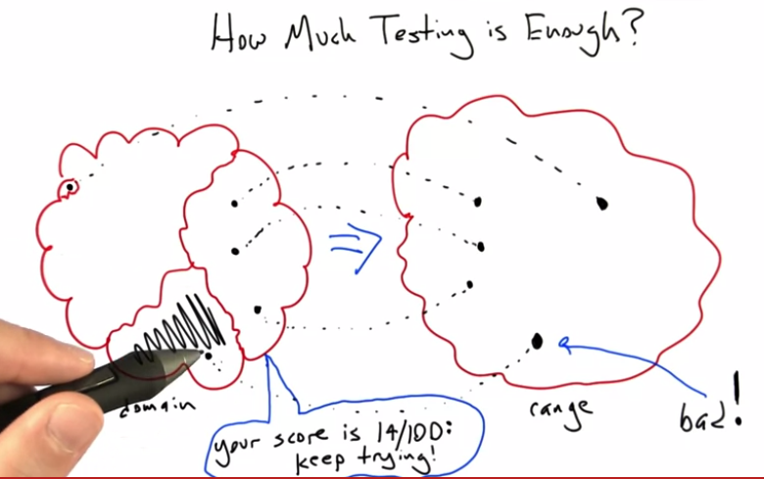

Slide 2
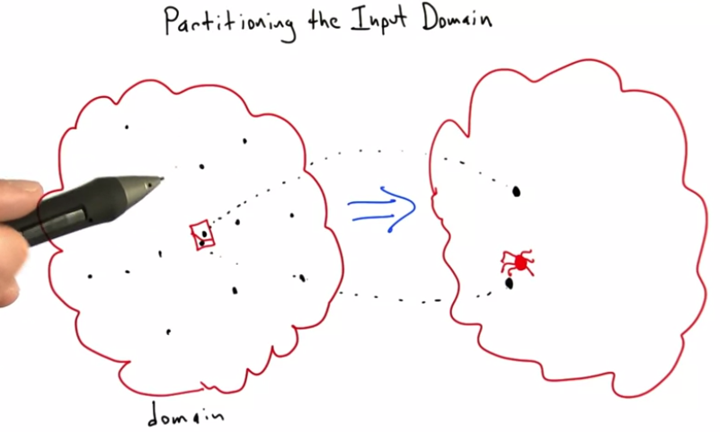

Slide 3
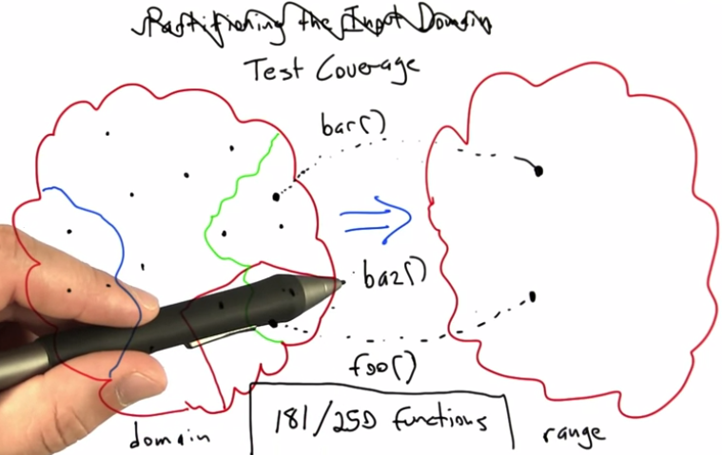

Slide 4
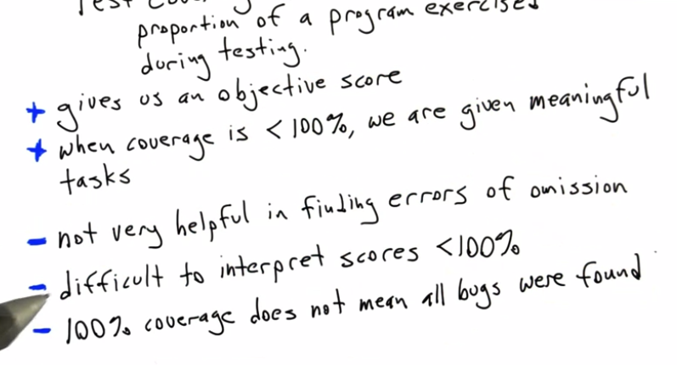

Slide 5
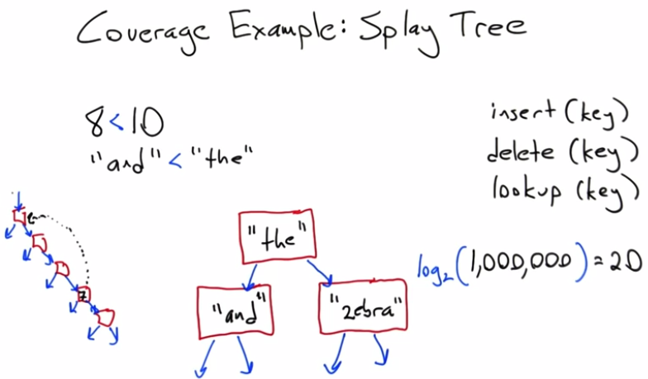

Slide 6
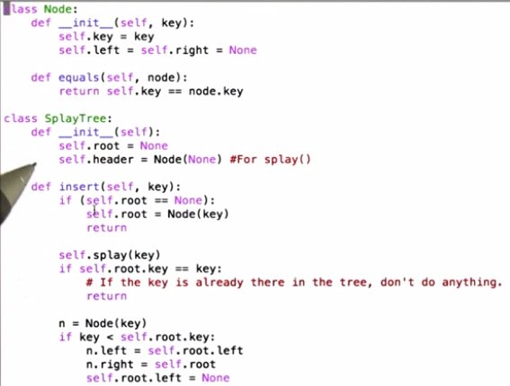

Slide 7
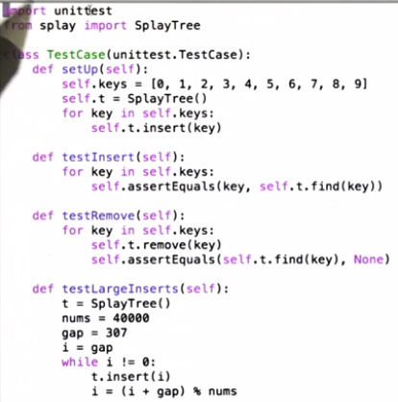

Slide 8
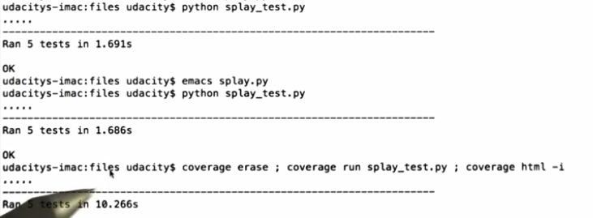

Slide 9
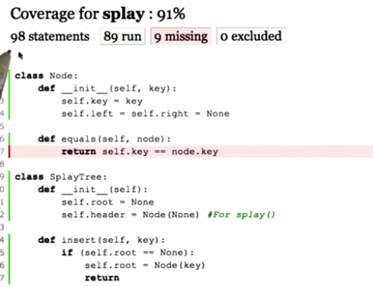

Slide 10
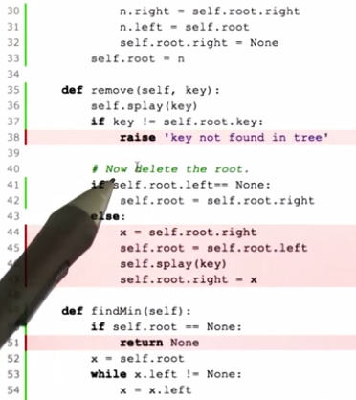

Slide 11
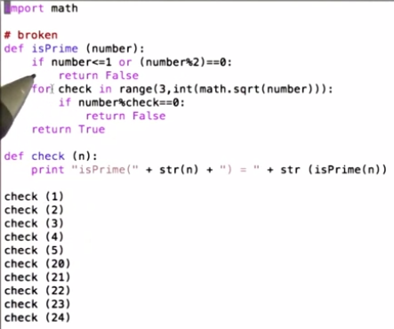
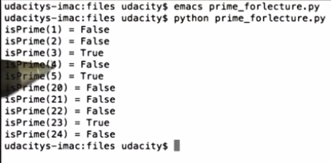

Slide 12
# CORRECT SPECIFICATION:
#
# isPrime checks if a positive integer is prime.
#
# A positive integer is prime if it is greater than
# 1, and its only divisors are 1 and itself.
#
# TASKS:
#
# 1) Add an assertion to test() that shows
# isPrime(number) to be incorrect for
# some input.
#
# 2) Write isPrime2(number) to correctly
# check if a positive integer is prime.
import math
def isPrime(number):
if number == 2:
return True
if number<=1 or (number%2)==0:
return False
for check in range(3,int(math.sqrt(number))):
if (number%check) == 0:
return False
return True
def isPrime2(number):
###Your isPrime2 code here.
pass
def test():
assert isPrime(1) == False
assert isPrime(2) == True
assert isPrime(3) == True
assert isPrime(4) == False
assert isPrime(5) == True
assert isPrime(20) == False
assert isPrime(21) == False
assert isPrime(22) == False
assert isPrime(23) == True
assert isPrime(24) == False
###Your test code here. 9 fail – Test coverage did not found the bug because it measures if every statement is executed at least once.
pass
def isPrime2(number):
if number <= 1:
return False
if number == 2:
return True
if number % 2 == 0:
return False
i = 3
while i*i <= number:
if number % i == 0:
return False
else:
++i
return True
pass

Slide 13
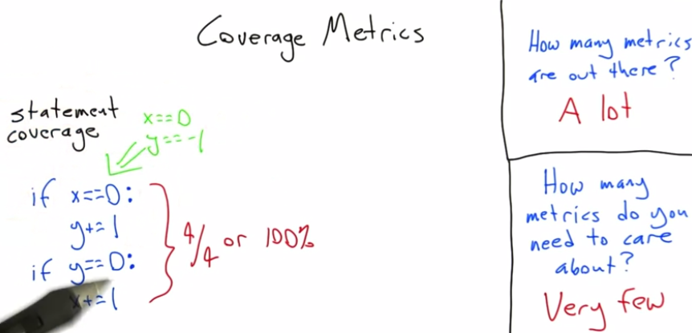

Slide 14
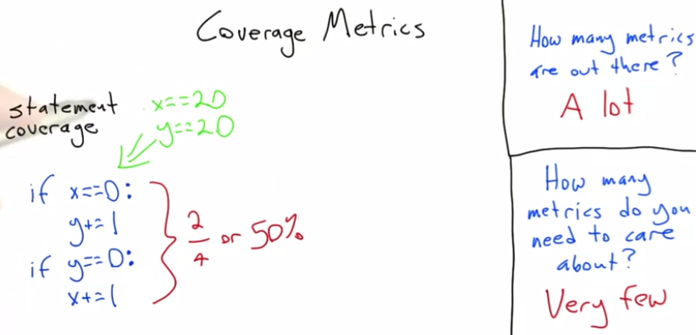

Slide 15
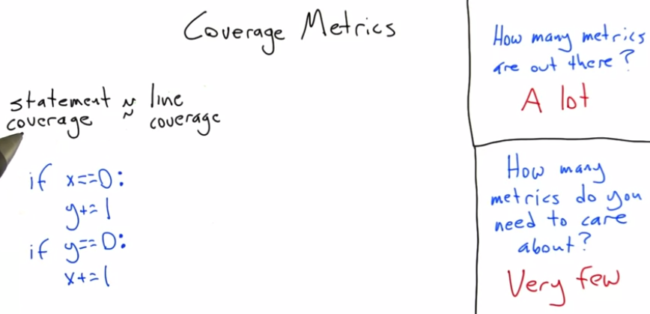

Slide 16
# SPECIFICATION:
#
# The stats function computes some basic statistics functions
# when given a list of numbers as input.
#
# TASK:
#
# Achieve full statement coverage on the stats function.
# All you should have to do is modify the test function
# to call stats with different lists of values.
def stats(lst):
min = None
max = None
freq = {}
for i in lst:
if min is None or i < min:
min = i
if max is None or i > max:
max = i
if i in freq:
freq[i] += 1
else:
freq[i] = 1
lst_sorted = sorted(lst)
if len(lst_sorted)%2 == 0:
middle = len(lst_sorted)/2
median = (lst_sorted[middle] + lst_sorted[middle-1]) / 2
else:
median = lst_sorted[len(lst_sorted)/2]
mode_times = None
for i in freq.values():
if mode_times is None or i > mode_times:
mode_times = i
mode = []
for (num, count) in freq.items():
if count == mode_times:
mode.append (num)
print "list = " + str(lst)
print "min = " + str(min)
print "max = " + str(max)
print "median = " + str(median)
print "mode(s) = " + str(mode)
def test():
###Your code here.
# Change l to something that manages full coverage. You may
# need to call stats twice with different input in order
# to achieve full coverage.
l = [31, 20, 31, 45]
stats(l)
l = [3]
stats(l)
test()

Slide 17
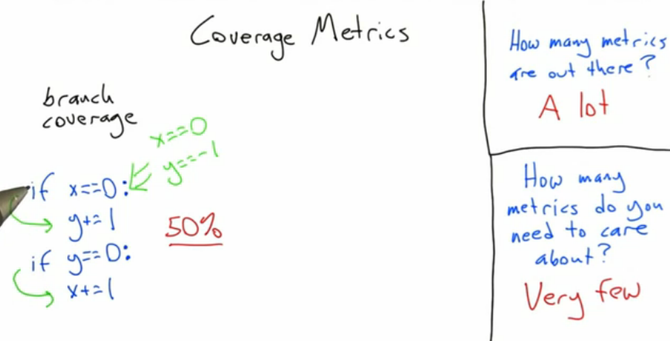

Slide 18
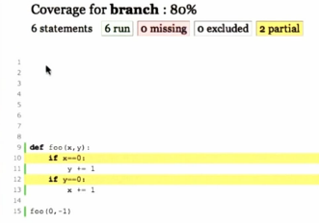

Slide 19
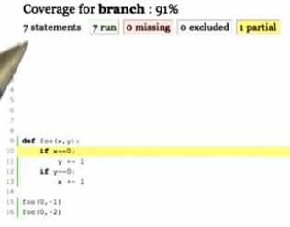

Slide 20
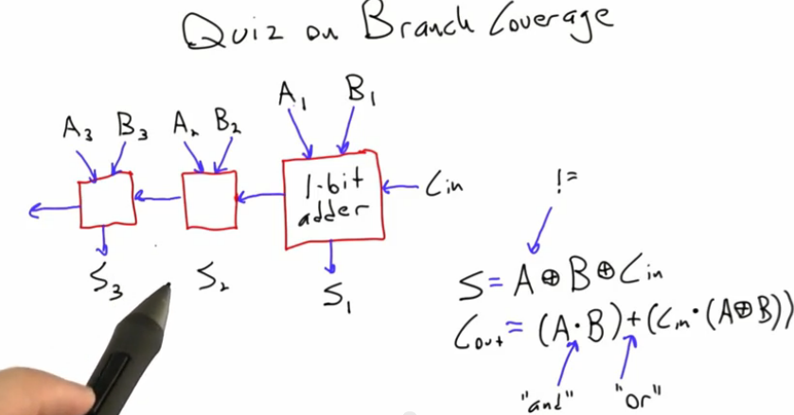

Slide 21
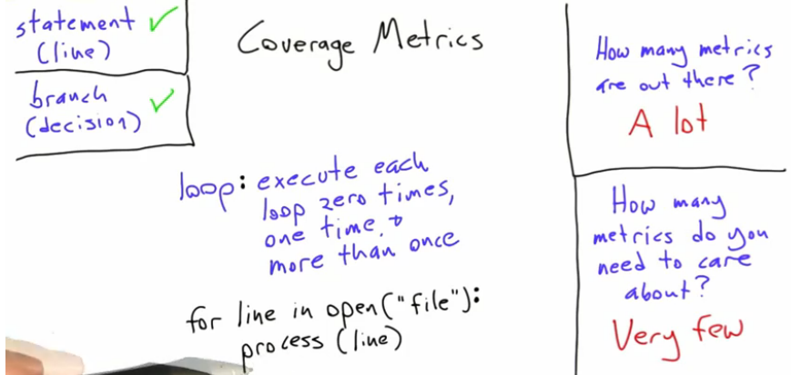

Slide 22
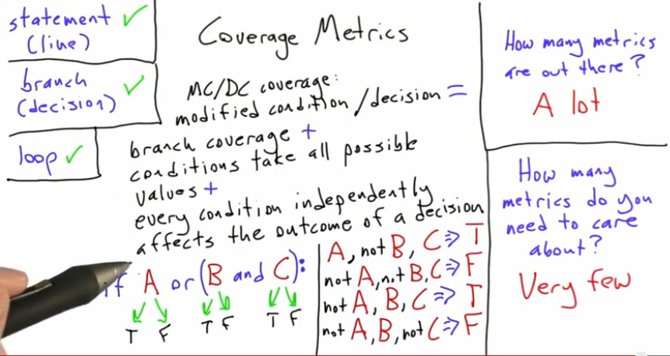

Slide 23
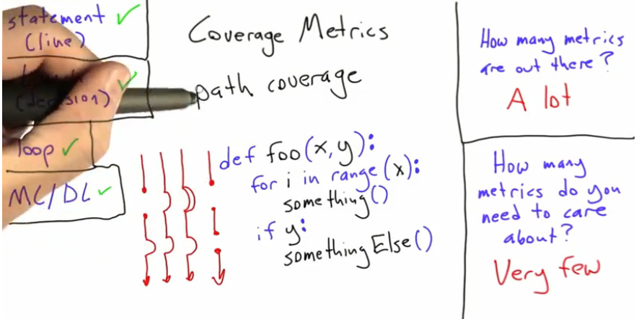

Slide 24
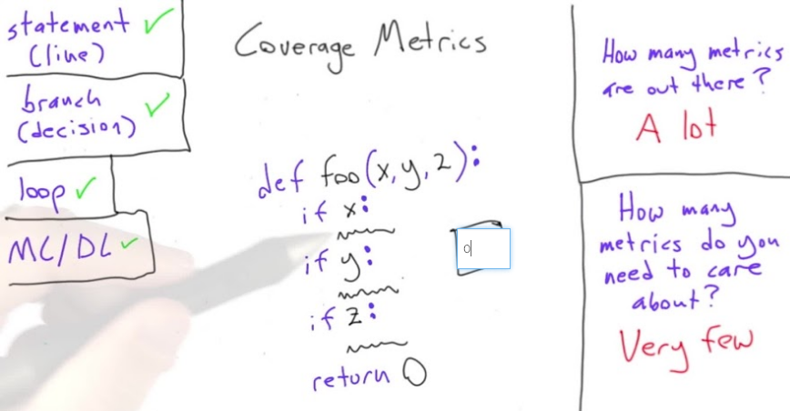

Slide 25
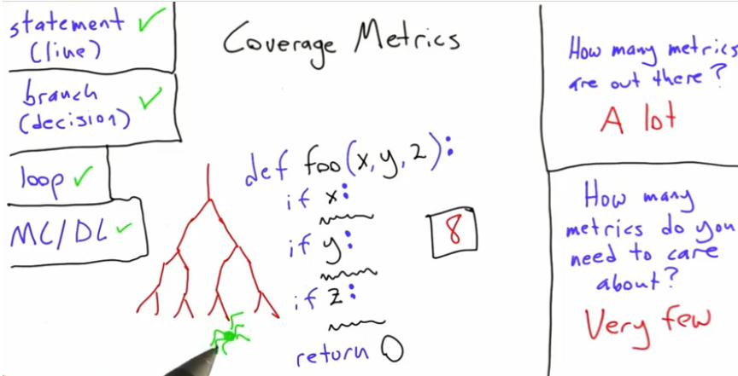

Slide 26
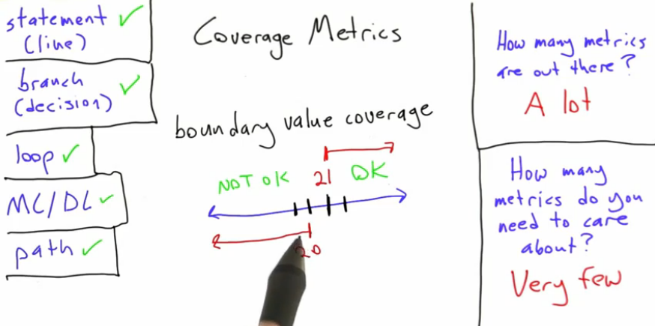

Slide 27
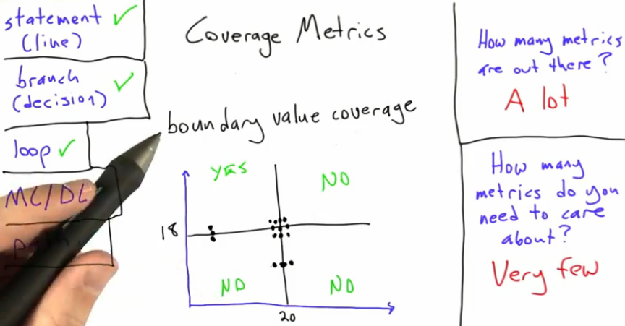

Slide 28
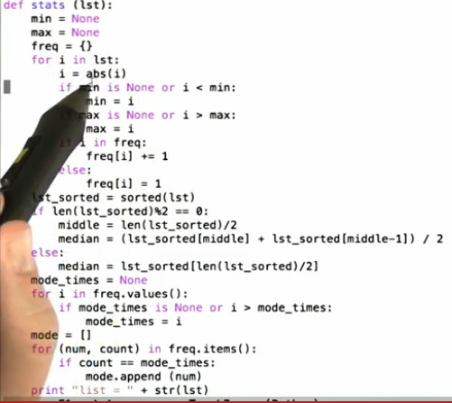

Slide 29
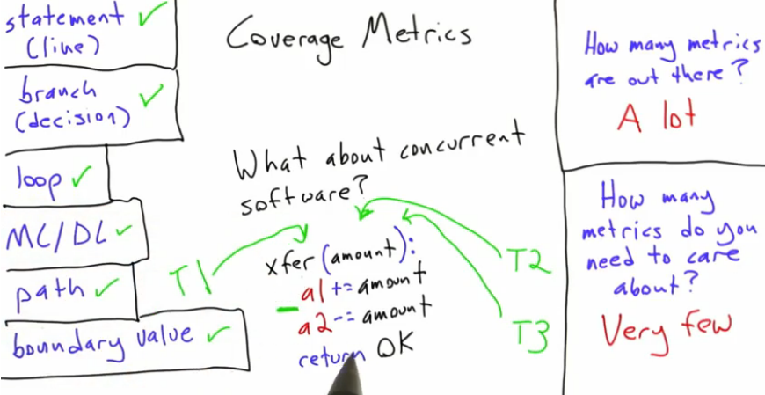

Slide 30
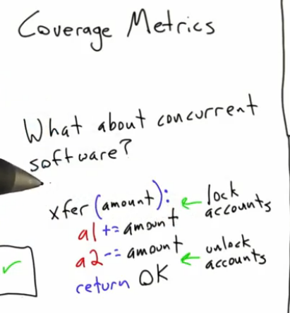

Slide 31
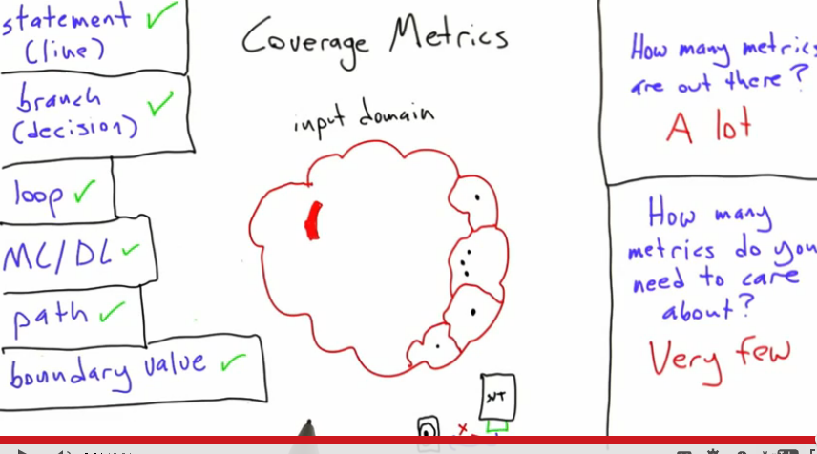

Slide 32
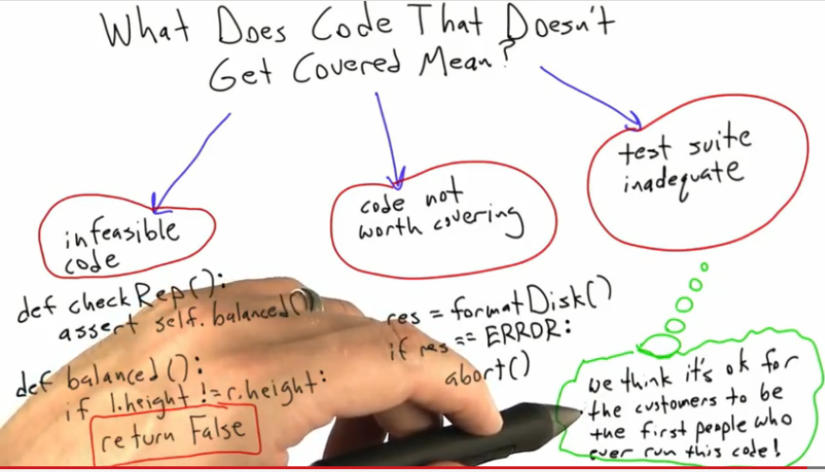

Slide 33
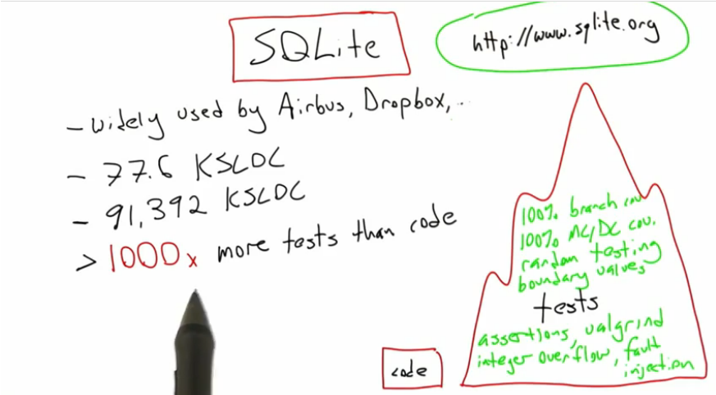

Slide 34
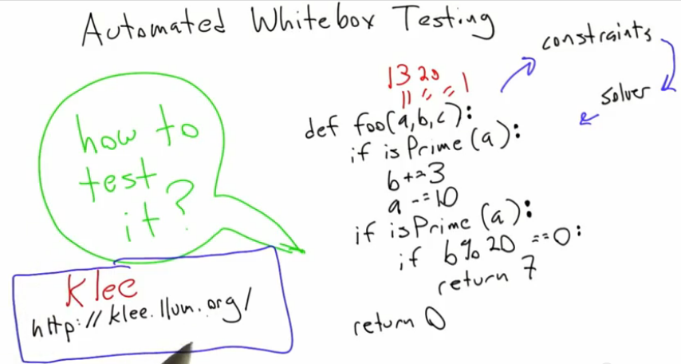

Slide 35
